Slide 1
ANIME RECOMMENDER SYSTEM
Group 233
ANWESHA KAKOTY (A20433149)
CHARMI KALANI (A20428706)

Slide 2
ABOUT THE DATASET
The data set contains information on user preference data. Each user is able to add anime to their completed list and give it a rating and this data set is a compilation of those ratings. The data has been provided by MyAnimeList website.
Content
Anime.csv
anime_id - myanimelist.net's unique id identifying an anime.
name - full name of anime.
genre - comma separated list of genres for this anime.
type - movie, TV, OVA, etc.
episodes - how many episodes in this show. (1 if movie).
rating - average rating out of 10 for this anime.
members - number of community members that are in this anime's "group".
Rating.csv
user_id - non identifiable randomly generated user id.
anime_id - the anime that this user has rated.
rating - rating out of 10 this user has assigned (-1 if the user watched it but didn't assign a rating).

Slide 3

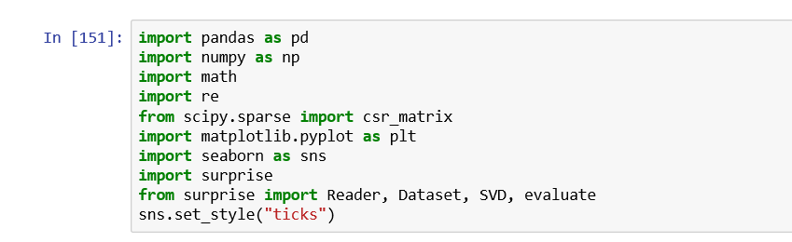
IMPORT LIBRARIES
For the particular recommender system, we have used SURPRISE library.
It is used for both Top-10 recommendation and for RMSE, MAE, Precision and Recall.

Slide 4
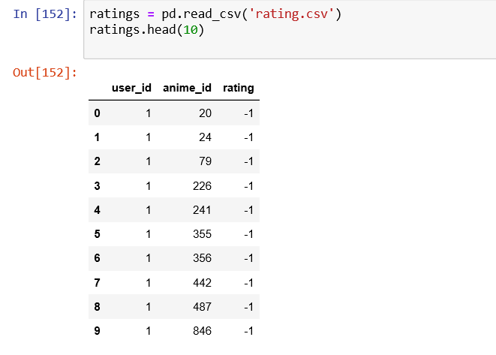
LOADING THE DATASET
Using the rating.csv file and loading it for implementing the recommender system.

Slide 5
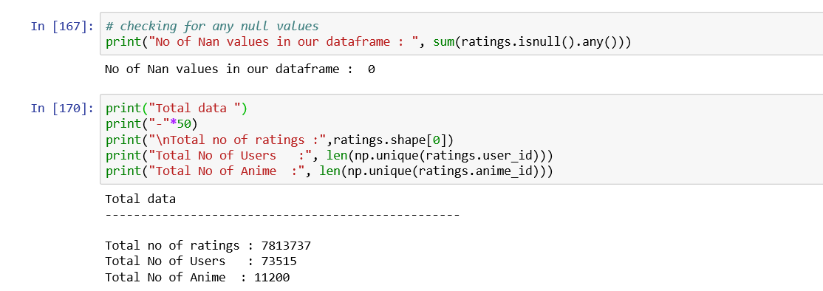
Information about dataset

Slide 6
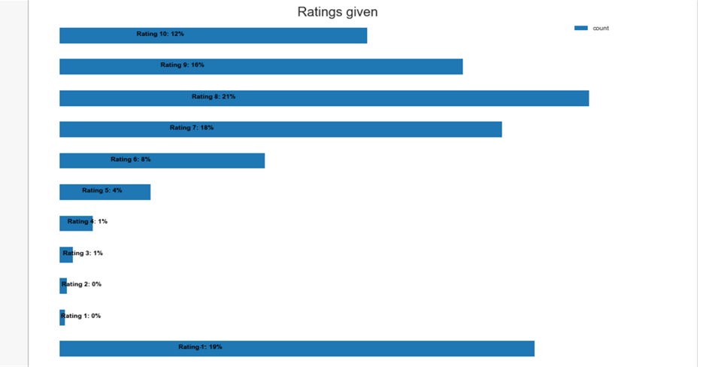
Percentage of the particular rating given

Slide 7
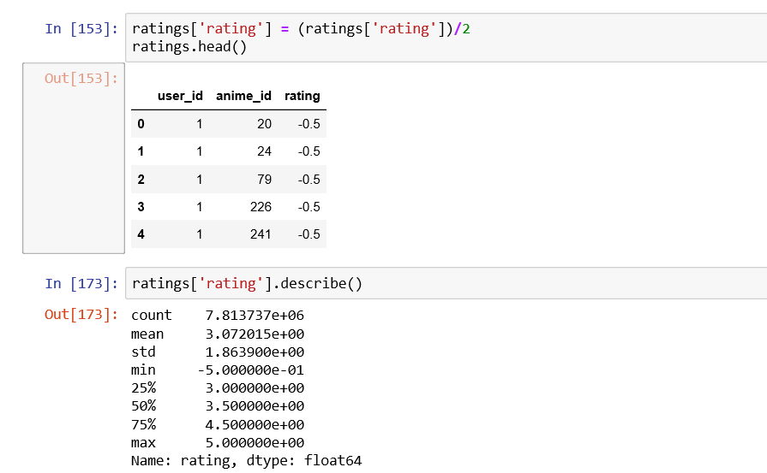
Description of the ratings file

Slide 8
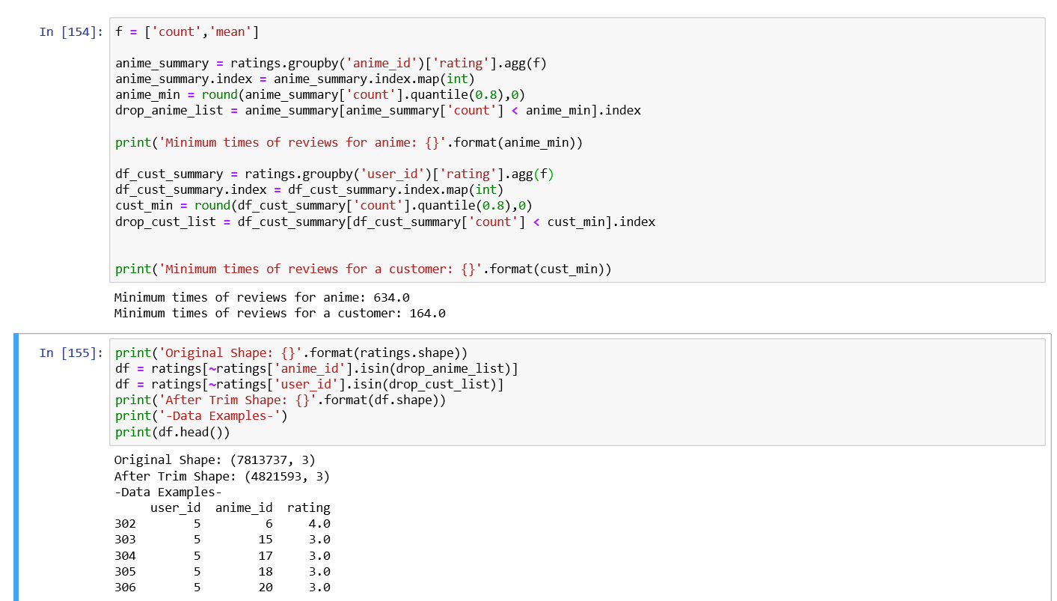
Preprocessing of dataset

Slide 9
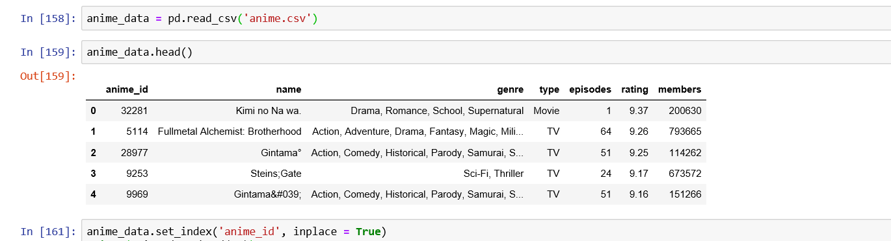
Loading the Anime dataset

Slide 10
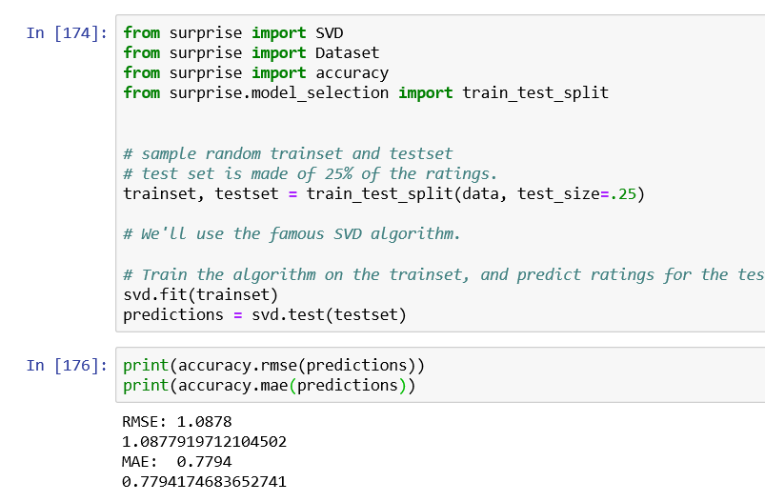
Building model using SVD (Singular Value Decomposition)
SVD decreases the dimension of the utility matrix by extracting its latent factors.
Essentially, we want to turn the recommendation problem into an optimization problem.
We can view it as how good we are in predicting the rating for items given a user.

Slide 11
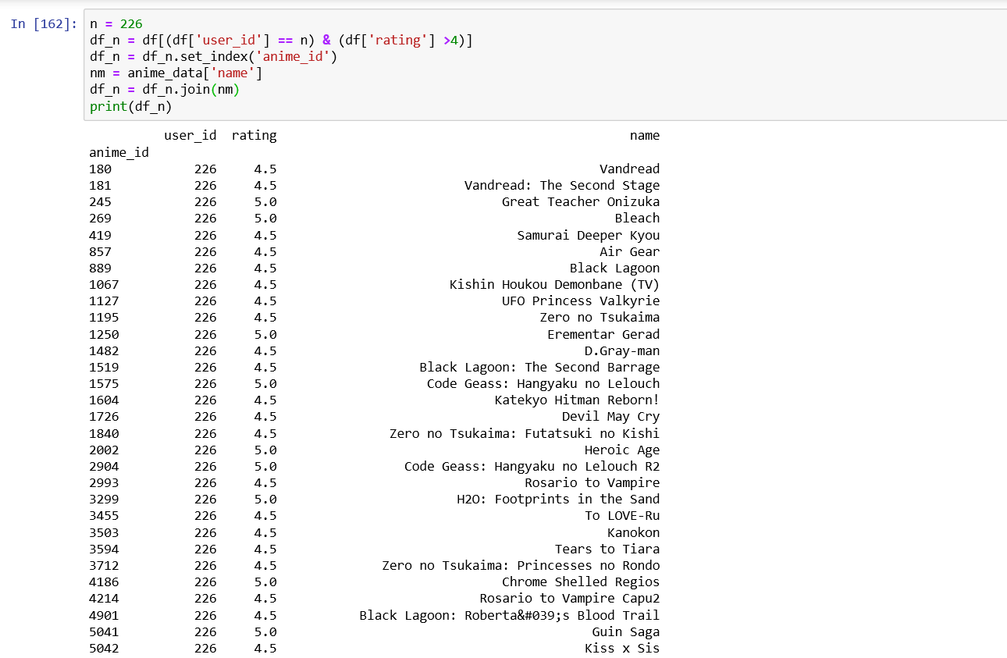
What user liked before

Slide 12
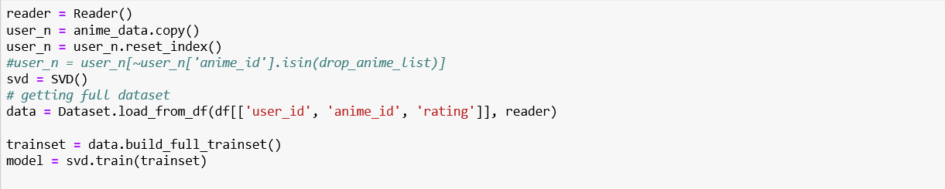
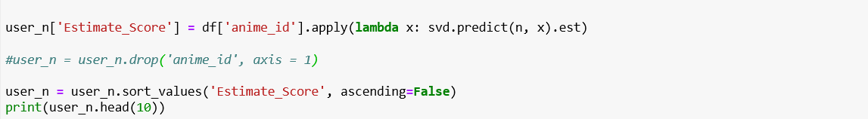
Predicting estimate score using SVD

Slide 13
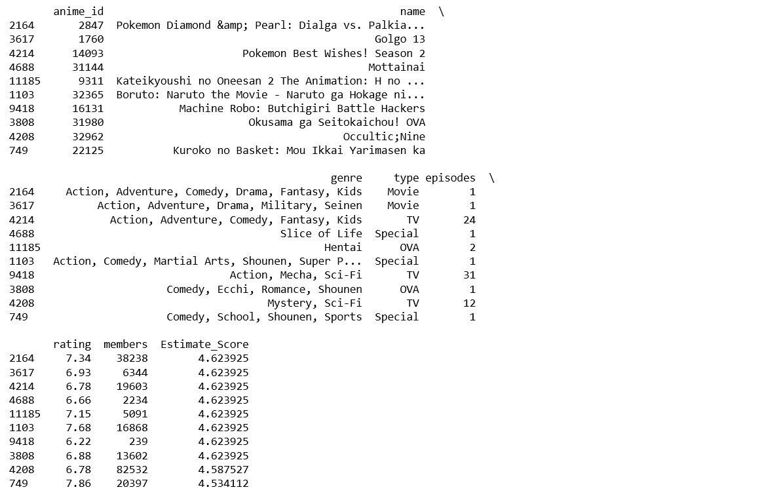
Top-10 Recommendations for particular user

Slide 14
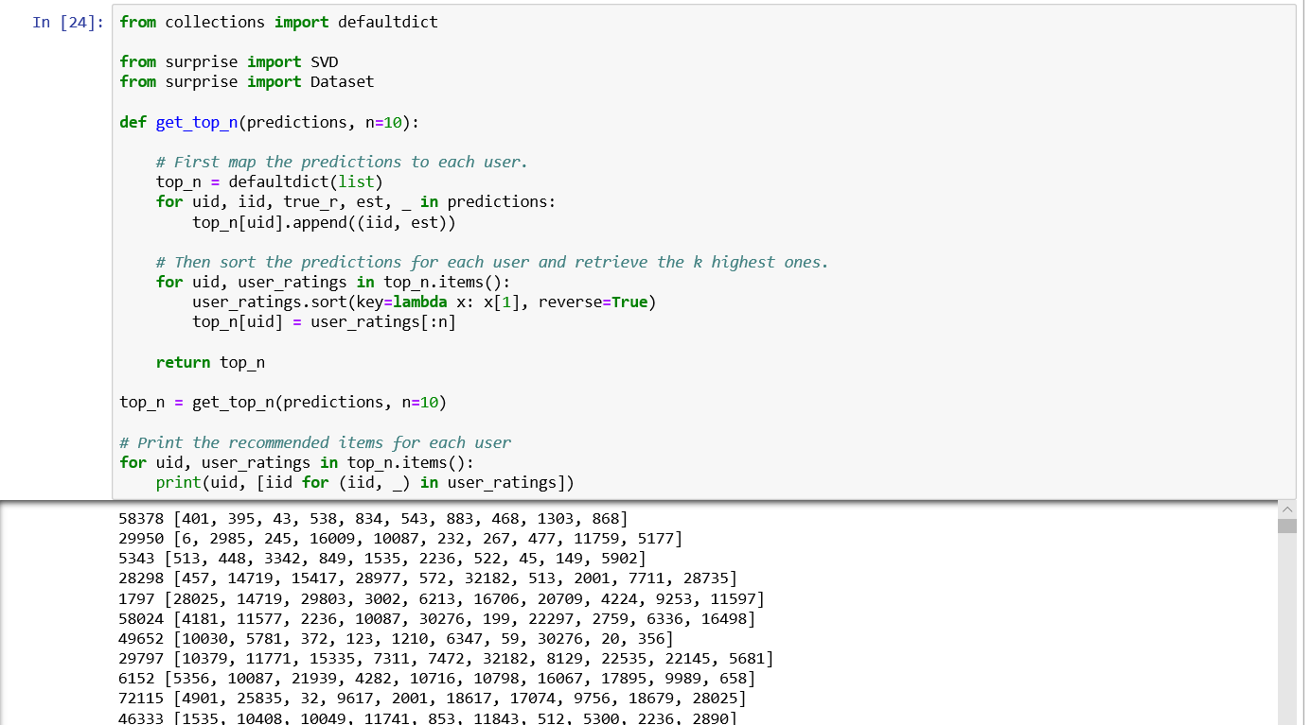
Top-10 Recommendations for all users

Slide 15
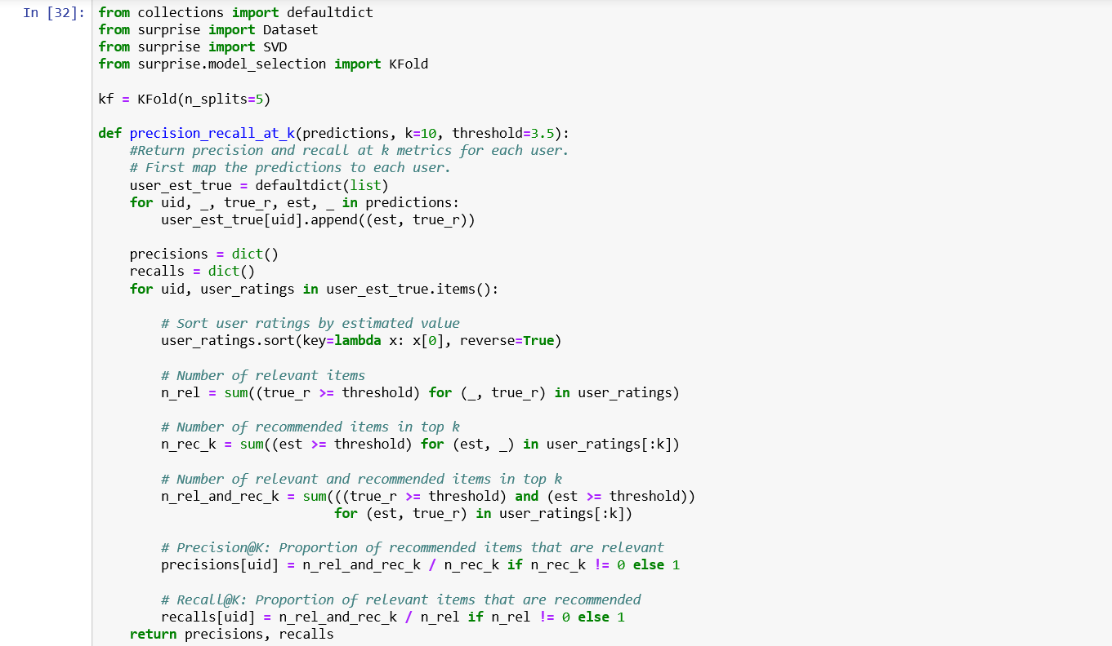
Evaluating Precision and Recall

Slide 16
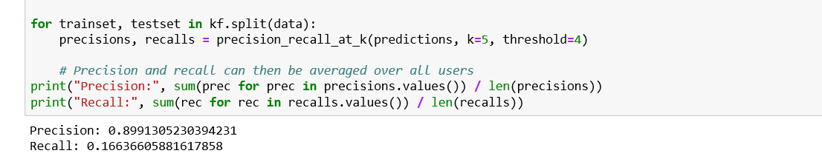
Precision recall for SVD

Slide 17
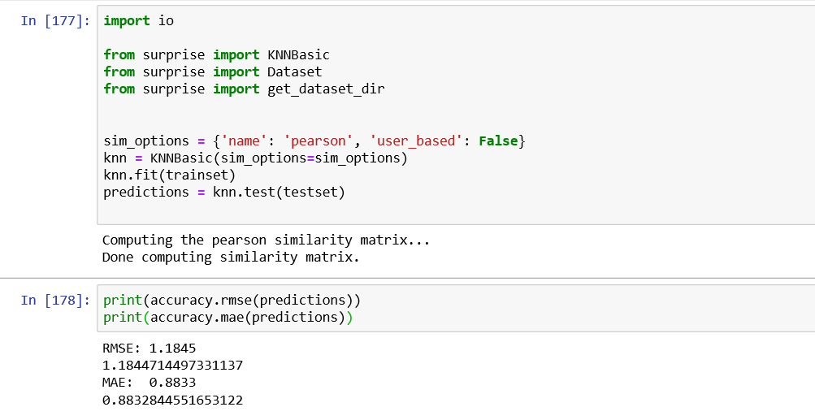
KNN Item based

Slide 18
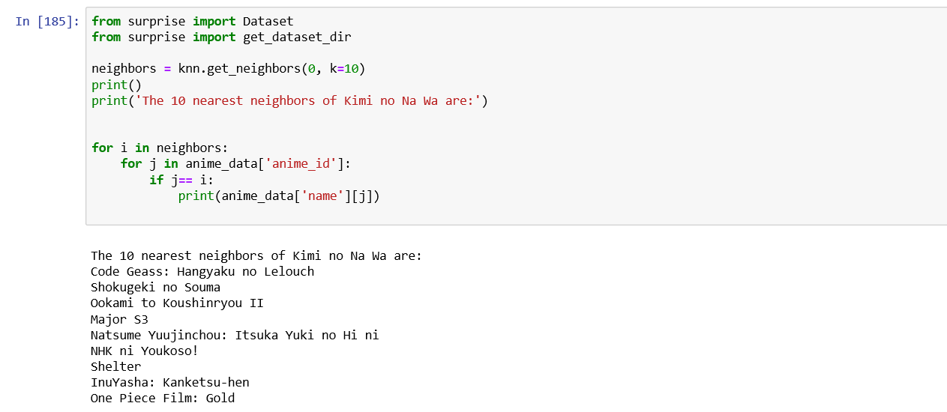
Predictions

Slide 19
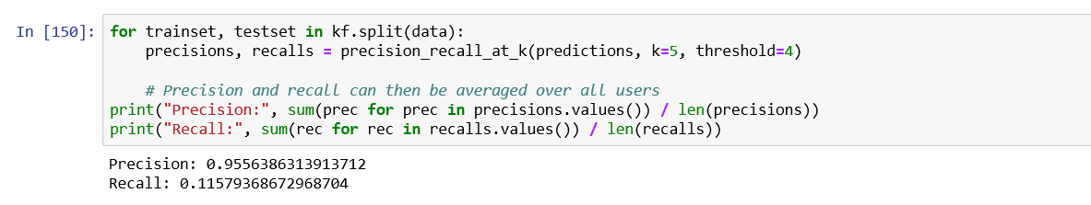
Precision recall for KNN

Slide 20
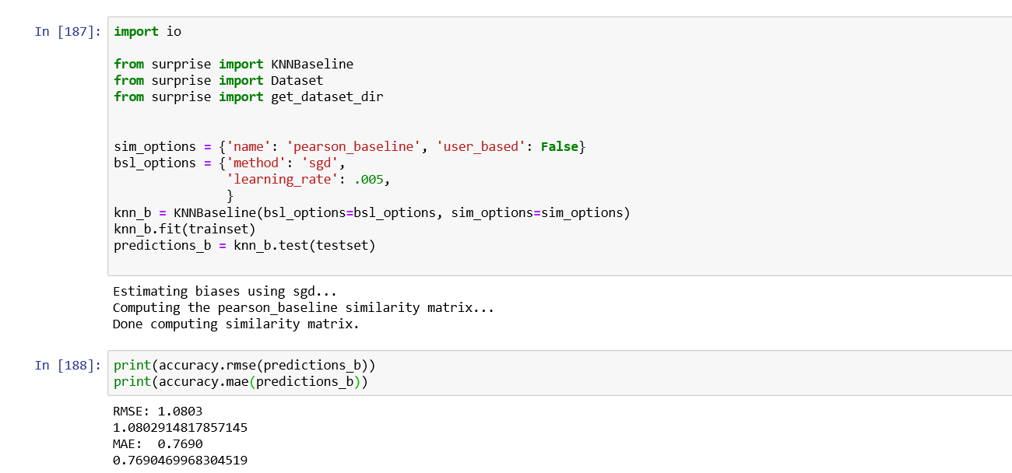
KNN BASELINE

Slide 21
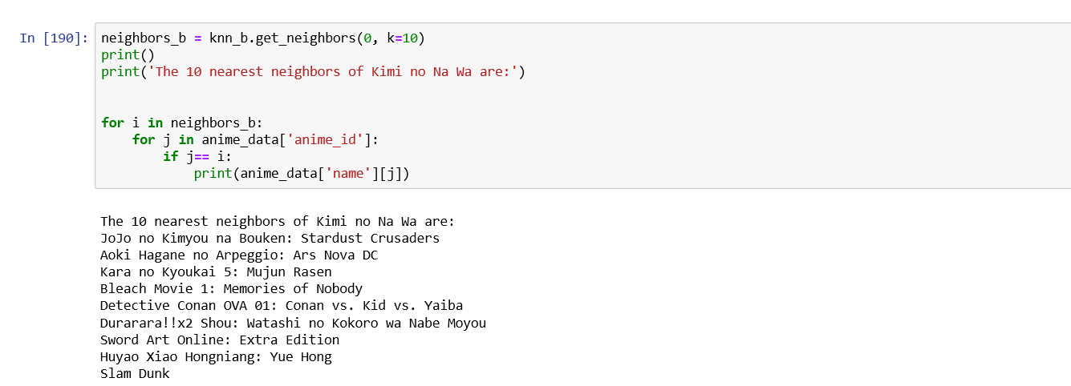
PREDICTIONS

Slide 22
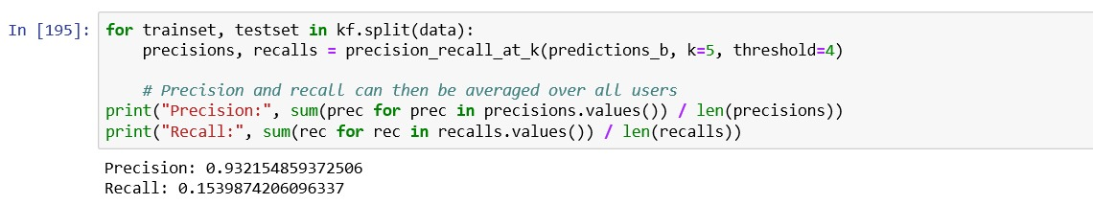
Precision recall for KNN Baseline

Slide 23
Conclusion
The above slides shows the results for all three algorithms.
Our project being an Offline Analytics System, we consider RMSE as the key factor and compare models according to the RMSE.
The above results show that, KNN Baseline has the least RMSE with RMSE being 1.0803.
The reason behind KNN being the best model is because according to Christopher Aberger’s paper on “An Analysis on Collaborative Filtering”, SGD stands to be the most promising algorithm for Recommender System amongst all the Matrix Factorization Algorithms.
Thus, KNN Baseline is the best model amongst all the three models.

Slide 24
Future Work
Use more collaborative filtering techniques like SVD++.
Develop a content based recommendation system.
Implement User-Based KNN.

Slide 25
Thankyou!

